Slide 1
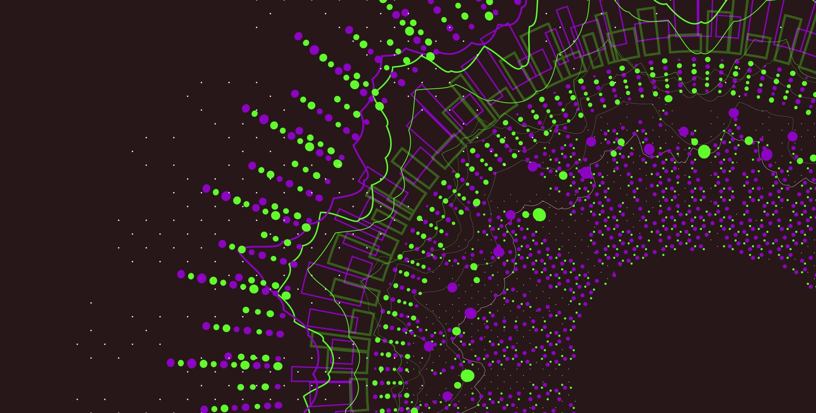
Anomaly Detection Techniques and Algorithm
MADE BY :
SHALU YADAV

Slide 2


What is an Anomaly?
Anomalies are those data points or values that deviates largely from the normal data points and exhibits unexpected or abnormal behaviour .

Slide 3
Anomaly Detection
Anomaly Detection
Machine Learning Algorithms
Supervised Machine Learning Algorithms
1. Local Outlier Factor
2. Support Vector Machine
Unsupervised Machine Learning Algorithms
1.DBSCAN
2. Isolation Forest
Statistical Techniques
1.Percentile
2.Standard Deviation
3.Interquartile Range
4. Z-score

Slide 4
METHODOLGY
s
Importing the libraries
Loading the dataset
Visualizing the dataset
Conclusion
Model Building
Model Training

Slide 5

Local Outlier Factor
Local outlier factor is probably the most common technique for anomaly detection. This algorithm is based on the concept of the local density. It compares the local density of an object with that of its neighbouring data points. If a data point has a lower density than its neighbours, then it is considered an outlier.

Slide 6
Support Vector Machine
Support vector machine (SVM) is also a supervised machine learning algorithm often used for classification. SVMs use hyperplanes in multi-dimensional space to divide data points into classes. The hyperparameter nu is the threshold (percentage) for outliers which you have to choose manually.
SVM is usually applied when there are more than one classes involved in the problem. However, in anomaly detection it is also used for single class problems. The model is trained to learn the ‘norm’ and can identify whether unfamiliar data belongs to this class or represents an anomaly.

Slide 7

DBSCAN
This is an unsupervised ML algorithm based on the principle of density. DBSCAN is able to uncover clusters in large spatial datasets by looking at the local density of the data points and generally shows good results when used for anomaly detection. The points that do not belong to any cluster get their own class: -1 so they are easy to identify. This algorithm handles outliers well when the data is represented by non-discrete data points.

Slide 8

Isolation Forest
Isolation Forests(IF), similar to Random Forests, are build based on decision trees. And since there are no pre-defined labels here, it is an unsupervised model.
IsolationForests were built based on the fact that anomalies are the data points that are “few and different”.
In an Isolation Forest, randomly sub-sampled data is processed in a tree structure based on randomly selected features. The samples that travel deeper into the tree are less likely to be anomalies as they required more cuts to isolate them. Similarly, the samples which end up in shorter branches indicate anomalies as it was easier for the tree to separate them from other observations.

Slide 9
Comparison of Algorithms
Algorithms | Predicted Anomalies | Accuracy | Total Anomalies
Support Vector Machine | 2216 | 86% | 776
Local Outlier Factor | 764 | 95.17% | 776
Isolation Forest | 762 | 95.18 % | 776
DBSCAN | 156 | - | 776

